Slide 1
chaper 2
e
Introduction to
Structured Query
Language

Slide 2
4. Submitting SQL Statements to the DBMS
Before continuing the explanation of SQL, it will be useful for you to learn how to submit SQL statements to specific DBMS products. That way, you can work along with the text by keying and running SQL statements as you read the discussion. The particular means by which you submit SQL statements depends on the DBMS. Here we will describe the process for Microsoft Access, Microsoft SQL Server, Oracle Database, and Oracle MySQL.
By the way You can learn SQL without running the queries in a DBMS, so if for some
reason you do not have Microsoft Access, SQL Server, Oracle Database, or MySQL readily
available, do not despair. You can learn SQL without them. Chances are your instructor,
like a lot of us in practice today, learned SQL without a DBMS. It is just that SQL
statements are easier to understand and remember if you can run the SQL while you read.
Given that there are freely downloadable versions of Microsoft SQL Server 2008 R2
Express edition, Oracle Database 10g Express Edition, and Oracle MySQL Server
Community Edition, you can have an installed DBMS to run these SQL examples even if
you have not purchased Microsoft Access. See Chapters 10, 10A, and 10B for specific
instructions for creating databases using each of these products. The SQL scripts needed to
create the Cape Codd Outdoor Sports database used in this chapter are available at
www.pearsonhighered.com/kroenke.

Slide 3
4. Submitting SQL Statements to the DBMS
Using SQL in Microsoft Access 2007
Before you can execute SQL statements, you need a computer that has Microsoft Access installed, and you need a Microsoft Access database that contains the tables and sample data in Figure 2-5. Microsoft Access is part of many versions of the Microsoft Office suite, so it should not be too difficult to find a computer that has it.
Because Microsoft Access is commonly used in classes that use this book as a textbook, we will look how to use SQL in Microsoft Access in some detail. Before we proceed, however, we need to discuss a specific peculiarity of Microsoft Access—the limitations of the default version of SQL used in Microsoft Access.
“Does Not Work with Microsoft Access ANSI-89 SQL”
As mentioned previously, our discussion of SQL is based on SQL features present in SQL standards since the ANSI SQL-92 standard (which Microsoft refers to as ANSI-92 SQL). Unfortunately, Microsoft Access 2010 still defaults to the earlier SQL-89 version—Microsoft calls it ANSI-89 SQL or Microsoft Jet SQL (after the Microsoft Jet DBMS engine used by Microsoft Access). ANSI-89 SQL differs significantly from SQL-92, and, therefore, some features of the SQL-92 language will not work in Microsoft Access.

Slide 4
4. Submitting SQL Statements to the DBMS
Using SQL in Microsoft Access 2007
Microsoft Access 2010 (and the earlier Microsoft Access 2003 and 2007 versions) does contain a setting that allows you to use SQL-92 instead of the default ANSI-89 SQL. Microsoft included this option to allow Microsoft Access tools such as forms and reports to be used in application development for Microsoft SQL Server, which supports newer SQL standards. To set the option in Microsoft Access 2010, click the File command tab and then click the Options command to open the Access Options dialog box. In the Access Options dialog box, click the Object Designers button to display the Access Options Object Designers page, as shown in Figure 2-5.
As shown in Figure 2-5, the SQL Server Compatible Syntax (ANSI 92) options control which version of SQL is used in a Microsoft Access 2010 database. If you check the This database check box, you will use SQL-92 syntax in the current database. Or, you can check the Default for new databases check box to make SQL-92 syntax the default for all new databases you create. When you click the OK button to save the changed SQL syntax option, the SQL-Syntax Information dialog box shown in Figure 2-6 will be displayed. Read the information, and then click the OK button to close the dialog box.

Slide 5
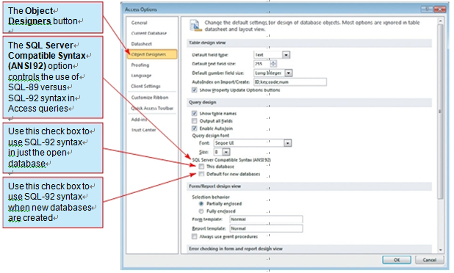
4. Submitting SQL Statements to the DBMS
Using SQL in Microsoft Access 2007
Figure 2-5
The Microsoft Access 2010 Options Object Designers Page

Slide 6
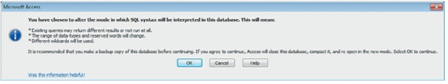
4. Submitting SQL Statements to the DBMS
Using SQL in Microsoft Access 2007
Figure 2-6
The Microsoft Access 2010 SQL-Syntax
Information Dialog Box
Unfortunately, very few Microsoft Access users or organizations using Microsoft
Access are likely to set the Microsoft Access SQL version to the SQL-92 option,
and, in this chapter, we assume that Microsoft Access is running in the default
ANSI-89 SQL mode. One advantage of doing so is that it will help you understand
the limitations of Microsoft Access ANSI-89 SQL and how to cope with them.

Slide 7
4. Submitting SQL Statements to the DBMS
Using SQL in Microsoft Access 2007
In the discussion that follows, we use “Does Not Work with Microsoft Access ANSI-89 SQL” boxes to identify SQL commands and SQL clauses that do not work in Microsoft Access ANSI-89 SQL. We also identify any workarounds that are available. Remember that the one permanent workaround is to choose to use the SQL-92 syntax option in the databases you create!
Nonetheless, two versions of the Microsoft Access 2010 Cape Codd Outdoor Sports database are available at www.pearsonhighered.com/kroenke for your use with this chapter.
The Microsoft Access database file named Cape-Codd.accdb is set to use Microsoft Access ANSI-89, whereas the Microsoft Access database file name Cape-Codd-SQL-92.accdb is set to use Microsoft Access SQL-92. Choose the one you want to use (or use them both and compare the results!). Note that these files contain two additional tables (INVENTORY and WARE-HOUSE) that we will not use in this chapter, but that you will need for the Review Questions at
the end of the chapter.

Slide 8
4. Submitting SQL Statements to the DBMS
Using SQL in Microsoft Access 2007
Alternatively, of course, you can create your own Microsoft Access database and then add the tables and data in Figures 2-3, 2-4, and 2-5, as described in Appendix A. If you create your own database, look at the Review Questions at the end of the chapter and create the INVENTORY and WAREHOUSE tables shown there in addition to the RETAIL_ORDER, ORDER_ITEM, and SKU tables shown in the chapter discussion. This will make sure that what you see on your monitor matches the screenshots in this chapter. Whether you download the database file or build it yourself, you will need to do one or the other before you can proceed.

Slide 9
4. Submitting SQL Statements to the DBMS
Processing SQL Statements in Microsoft Access 2007
To process an SQL statement in Microsoft Access 2010, first open the database in Microsoft Access as described in Appendix A and then create a new tabbed Query window.
Opening a Microsoft Access Query Window in Design View
Click the Create command tab to display the Create command groups, as shown in
Figure 2-7.
2. Click the Query Design button.
3. The Query1 tabbed document window is displayed in Design view, along with the
Show Table dialog box, as shown in Figure 2-8.
Click the Close button on the Show Table dialog box. The Query1 document window
now looks as shown in Figure 2-9. This window is used for creating and editing
Microsoft Access queries in Design view and is used with Microsoft Access QBE.
Note that in Figure 2-9 the Select button is selected in the Query Type group on the Design tab. You can tell this is so because active or selected buttons are always shown in color on the Ribbon. This indicates that we are creating a query that is the equivalent of an SQL SELECT statement.

Slide 10
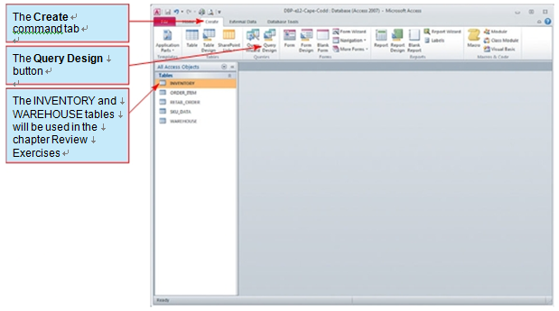
4. Submitting SQL Statements to the DBMS
Processing SQL Statements in Microsoft Access 2007
Figure 2-7
The Create Command Tab

Slide 11
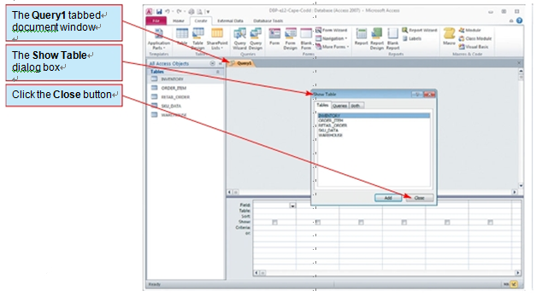
4. Submitting SQL Statements to the DBMS
Processing SQL Statements in Microsoft Access 2007
Figure 2-8
The Show Table Dialog Box

Slide 12
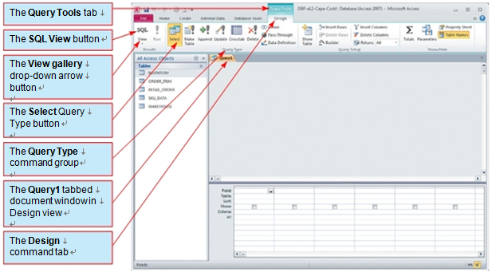
4. Submitting SQL Statements to the DBMS
Processing SQL Statements in Microsoft Access 2007
Figure 2-9
The Query Tools Contextual Command Tab

Slide 13
4. Submitting SQL Statements to the DBMS
Processing SQL Statements in Microsoft Access 2007
Also note that in Figure 2-10 the View gallery is available in the Results group of the Design tab. We can use this gallery to switch between Design view and SQL view. However, we can also just use the displayed SQL View button to switch to SQL view. The SQL View button is being displayed because Microsoft Access considers that to be the view you would most likely choose in the gallery if you used it. Microsoft Access always presents a “most likely needed” view choice as a button above the View gallery.
For our example SQL query in Microsoft Access, we will use SQL-Query-CH02-01, the first SQL query earlier in our discussion:
/* *** SQL-Query-CH02-01 *** */
SELECT Department, Buyer
FROM SKU_DATA;

Slide 14
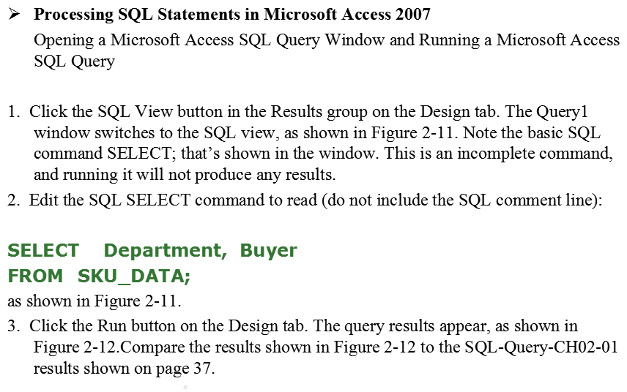
4. Submitting SQL Statements to the DBMS

Slide 15
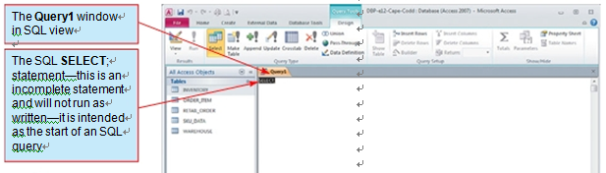
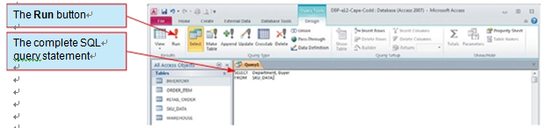
4. Submitting SQL Statements to the DBMS
Processing SQL Statements in Microsoft Access 2007
Figure 2-10
The Query1 Window in SQL View
Figure 2-11
The SQL Query

Slide 16
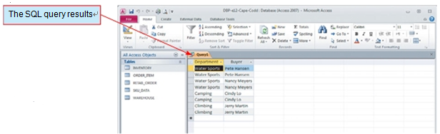
4. Submitting SQL Statements to the DBMS
Processing SQL Statements in Microsoft Access 2007
Figure 2-12
The SQL Query Results
Because Microsoft Access is a personal database and includes an application generator,
we can save Microsoft Access queries for future use. Enterprise-level DBMS products
generally do not allow us to save queries (although they do allow us to save SQL Views
within the database and SQL query scripts as separate files—we will discuss these methods
later).

Slide 17
4. Submitting SQL Statements to the DBMS
Saving a Microsoft Access SQL Query
1. To save the query, click the Save button on the Quick Access Toolbar. The Save As dialog box appears, as shown in Figure 2-13.
2. Type in the query name SQL-Query-CH02-01 and then click the OK button. The query is saved, and the window is renamed with the query name. As shown in Figure 2-14, the query document window is now named SQ-LQuery-CH02-01, and a newly
created SQL-Query-CH02-01 query object appears in a Queries section of the
Navigation Pane.
3. Close the SQL-Query-CH02-01 window by clicking the document window’s Close
button.
4. If Microsoft Access displays a dialog box asking whether you want to save changes to
the design of the query SQL-Query-CH02-01, click the Yes button.
At this point, you should work through each of the other nine queries in the preceding
discussion of the SQL SELECT/FROM/WHERE framework. Save each query as SQL-
Query-CH02-##, where ## is a sequential number from 02 to 09 that corresponds to the
SQL query label shown in the SQL comment line of each query.

Slide 18
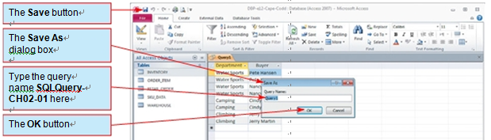
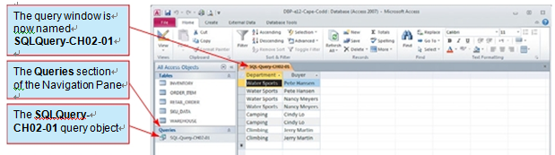
4. Submitting SQL Statements to the DBMS
Processing SQL Statements in Microsoft Access 2007
Figure 2-13
The Save As Dialog box
Figure 2-14
The Named and Saved Query

Slide 19
Thank You!
LOGO

